Slide 1
Optimizing Physical Hand Training Effectiveness Using Deep Learning and Unsupervised Learning
Names: Peter Asbæk Skøt (S185185) and Jacob Asbæk Wolf (S236897)
Course: Applied Machine Learning and Big Data
Course ID: 62T22
Exam Date: June 12, 2025

Slide 2
Agenda
1 min Motivation
1 min Problem and Use Case
2 min CNN Model
2 min K-Means Model
2 min Software Demo (Live Inference)
2 min Conclusion and Perspectives

Slide 3
Motivation
The situation
Imagine being 19 with CP and cognitive disabilities.
Hand therapy can improve your quality of life, but it is demotivating.
Jacob’s son had CP after a serious meningitis as a baby.
Our reflection
Could machine learning motivate and support training at home?
Our solution
A simple software solution providing live motivational feedback.
We will now show you what we built…

Slide 4
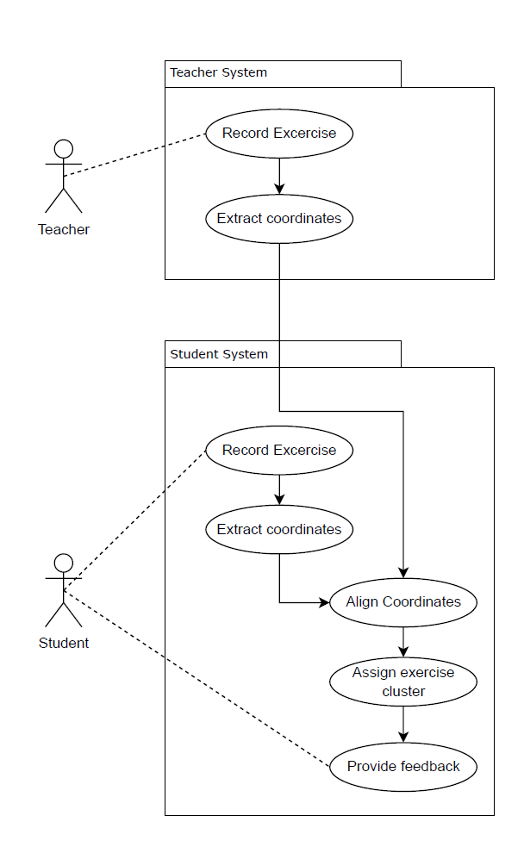
Problem and Use Case
Problem
Hand exercise training targeted for patients with hand mobility issues with the goal of making the training more effective and the patient more motivated.
Hereunder:
Track hand positions.
Rate the students hand positions against the teacher’s hand positions.
Apply supervised and unsupervised machine learning to a live stream
Use Case

Slide 5
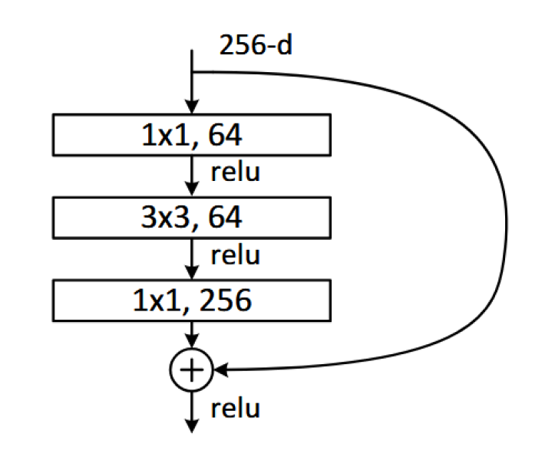
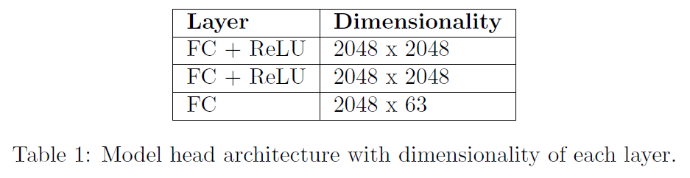
CNN Model
Purpose:
Extract 3D landmarks from an image input.
Model data
Data source: HanCo
Input data: 224x224 RGB images of hands
Output data: 21 normalised 3D coordinates of landmarks.
Model Architecture
Backbone: ResNet50 + custom model head
Pretrained weights: ImageNet

Slide 6
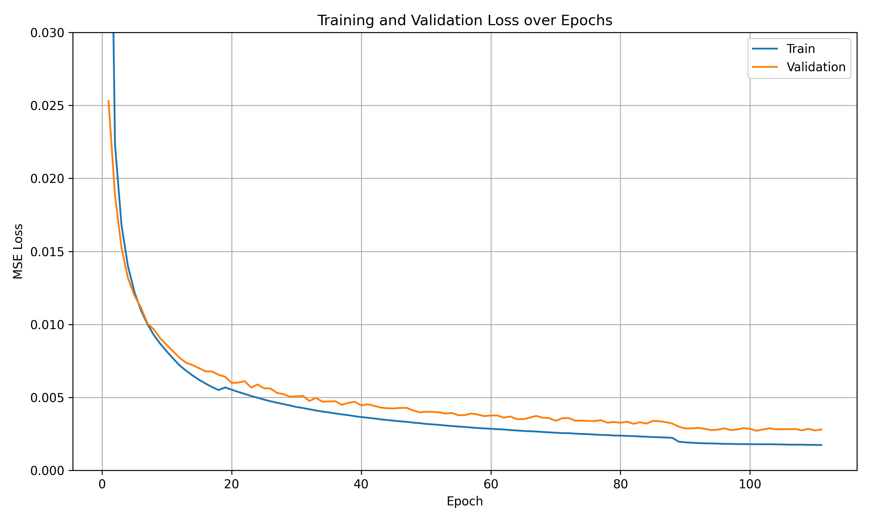
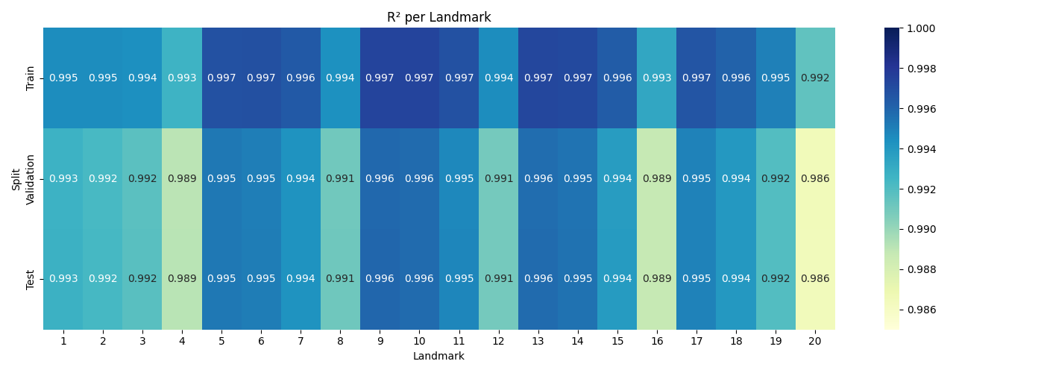
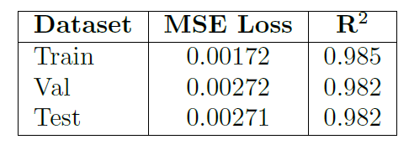
CNN Results
Strong within-dataset generalisation
R² of 0.982 on test set
Healthy loss curve with small train/val gap.
High variance explainability across all landmarks

Slide 7
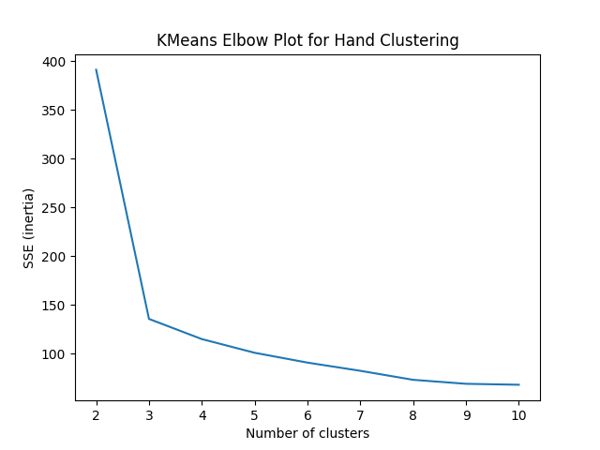
K-Means Model
Purpose
Cluster landmarks into different exercise states
Model Data
Data Source: CNN prediction on self collected images (1174)
Input Data:
21 normalised 3D coordinates of landmarks
3 (1 good and 2 wrong) positions recorded (~400 each)
Aligned to canonical coordinate system
Output Data: 63 dimensional centroid for each cluster.
Cluster Selection
Elbow method used
Matches the expected 3 positions

Slide 8
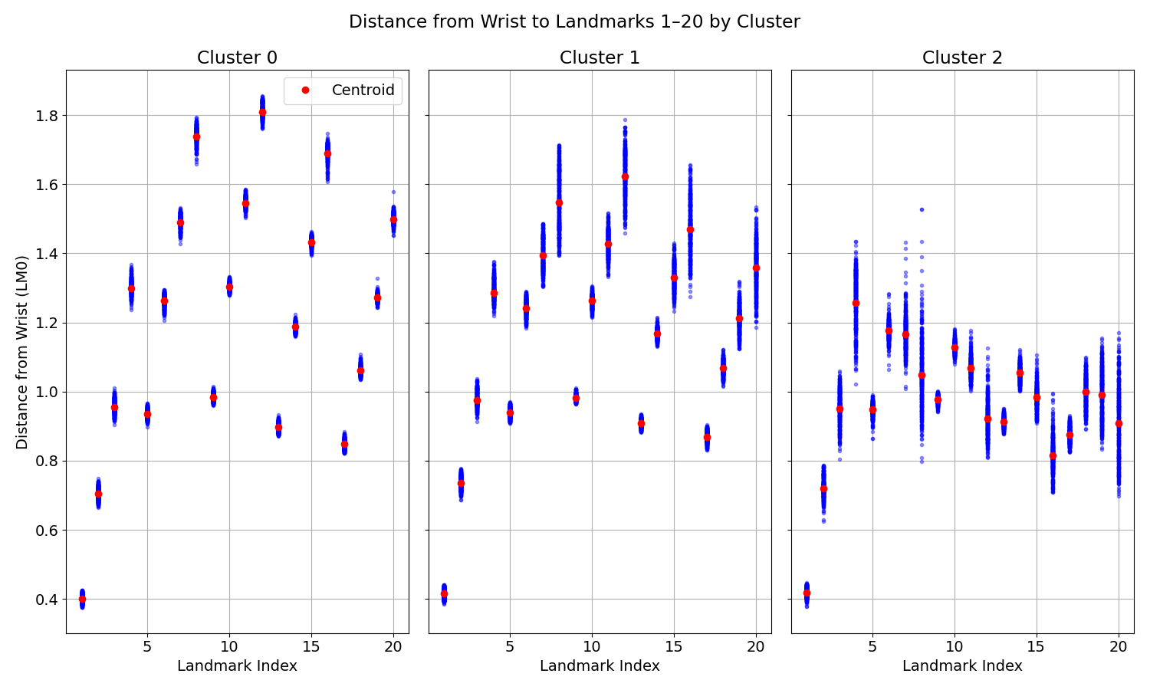
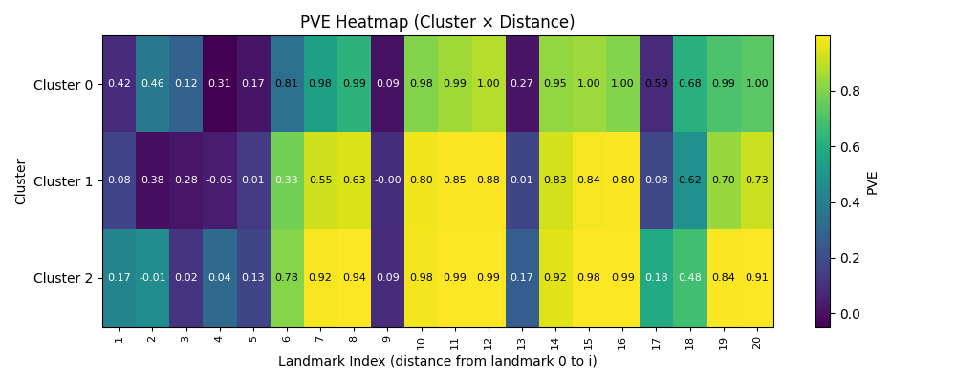
K-Means Results
Centroids match the exercise’s three positions well.
Wrist-landmark distances in each cluster matches our expectations from the three recorded image scenarios.
The datapoints distribute close to their centroids
PVE shows good explainability for landmarks further from the wrist (exluding the thumb).

Slide 9
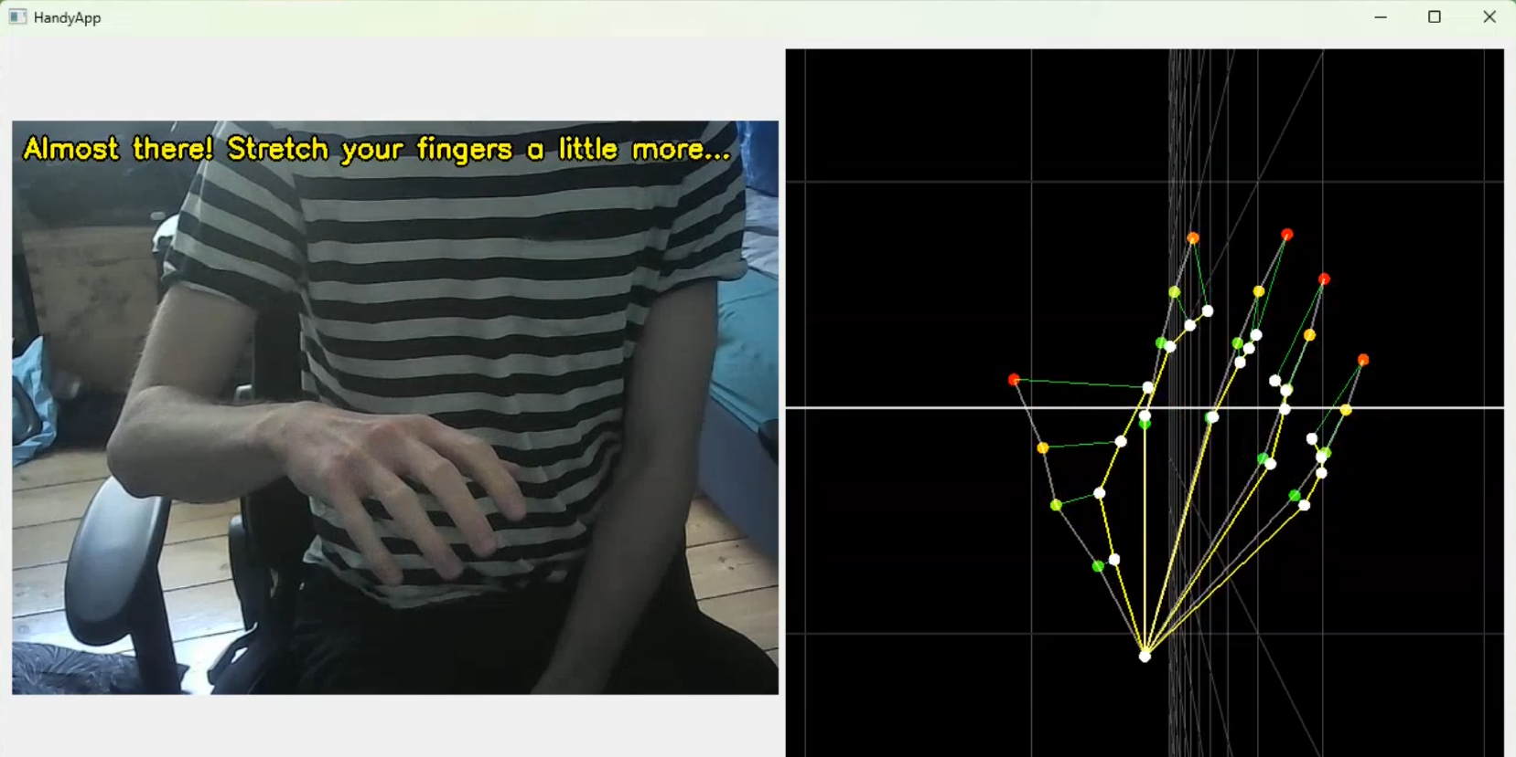
Software Demo (Live Inference)

Slide 10
Software Demo (Live Inference)

Slide 11
Conclusion
Good CNN performance/generalisation with R² = 0.982
Well performing K-means clustering matching our 3 scenarios
Well perfoming live-inference software capable of guiding the patient
Perspectives
Dataset expansion/ Fine tuning
More exercises
Data collection
Regulatory compliance
Faster detection/ Mobile devices
Telemedicine

